Slide 1


PSO AI GRAPH
KULDES

Slide 2

ARTIFICIAL INTELLIGENCE
Matlab for modeling simulation and getting the output of AI under certain error criteria / even smarter than we created
Java/Fortran/C for creating the fastest system because it is low level language and near machine.

Slide 3
DATA MINING
Matlab for modeling simulation and getting the output of AI under certain error criteria / even smarter than we created

Slide 4
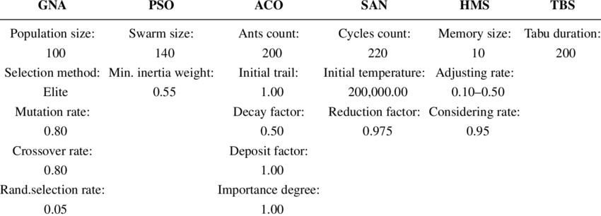
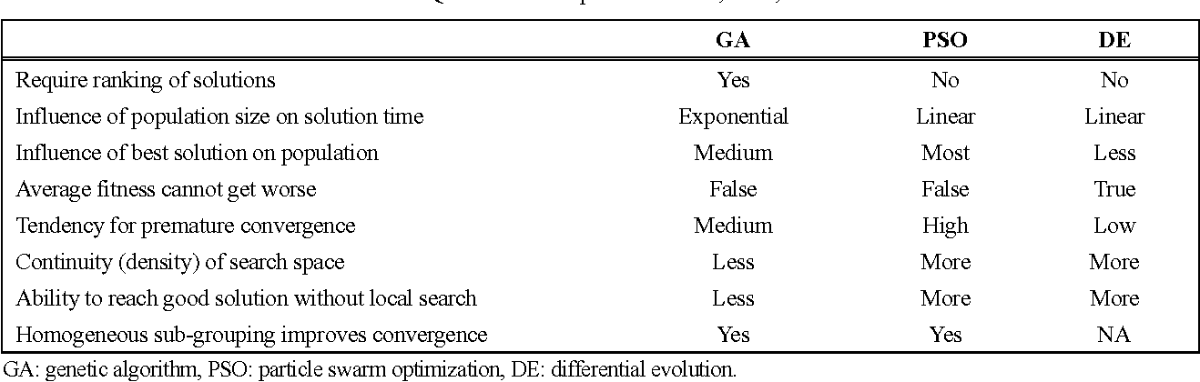
PSO
PSO gives 98% accuracy and is good for continuous inputs and troublesome if it converted to discrete
GA gives less accuracy than PSO but it can be used for both discrete and continuous without compatibility problem

Slide 5
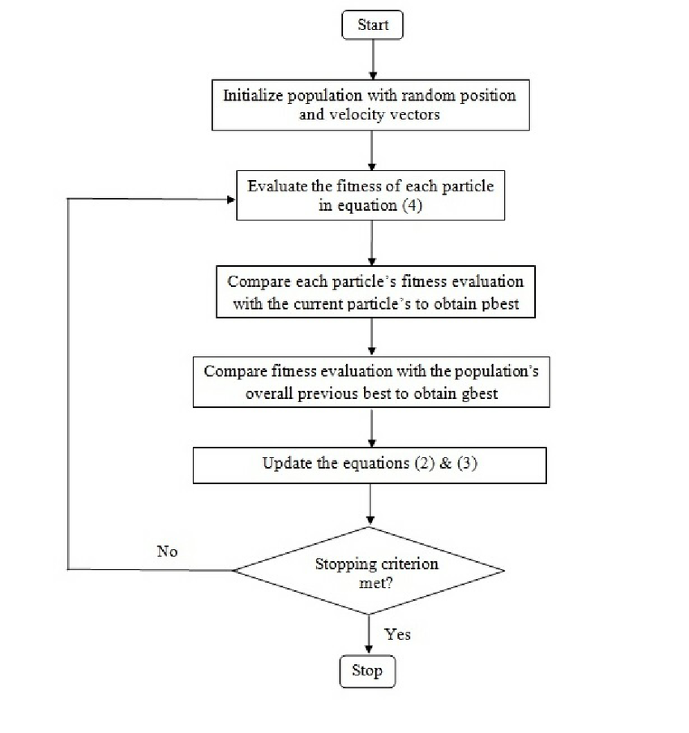
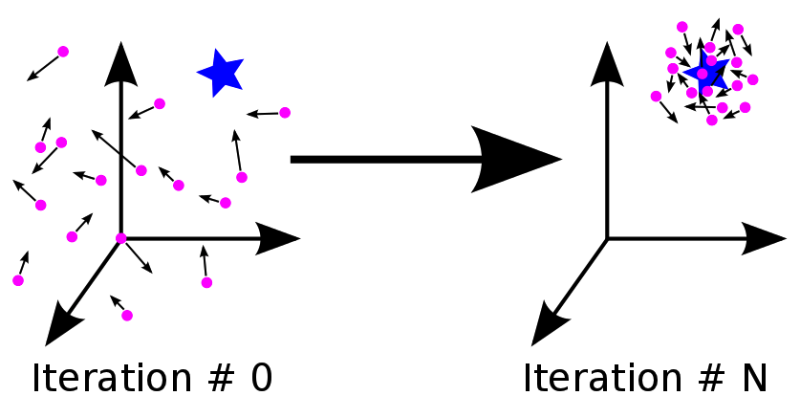
PSO
PSO gives 98% accuracy and is good for continuous inputs and troublesome if it converted to discrete

Slide 6

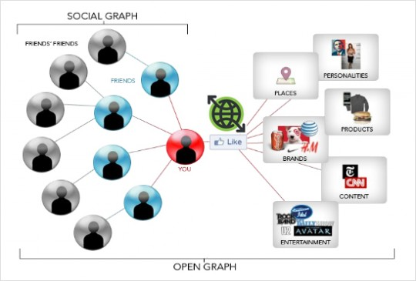
GRAPH THEORY

Slide 7
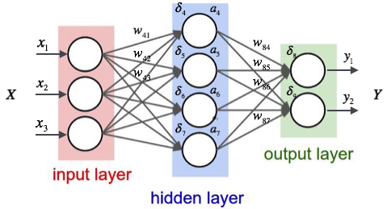
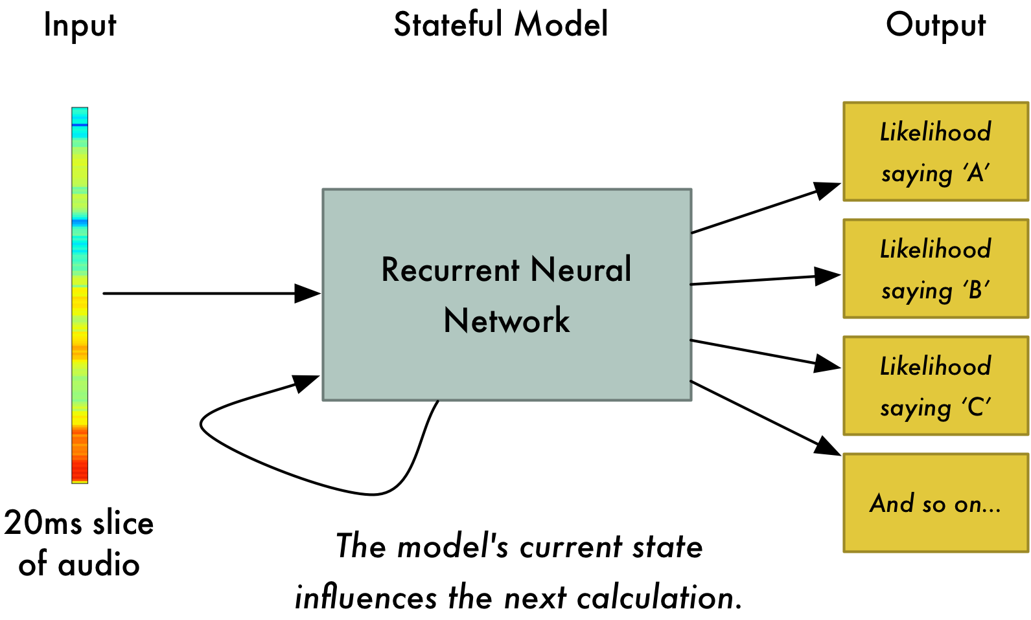
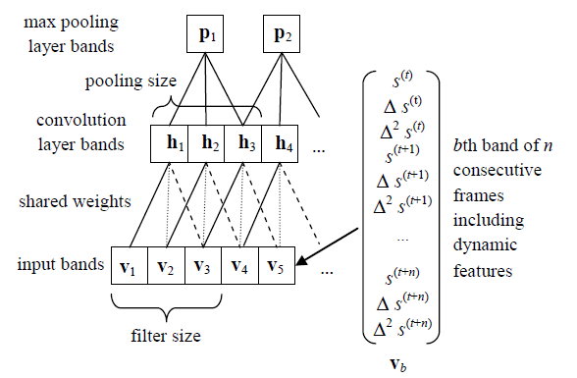
NEURAL NETWORK
Speech Recognition using Convolutional Neural Network

Slide 8
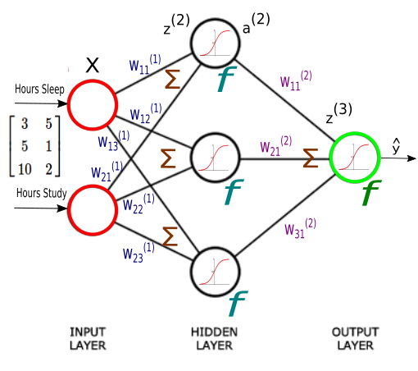
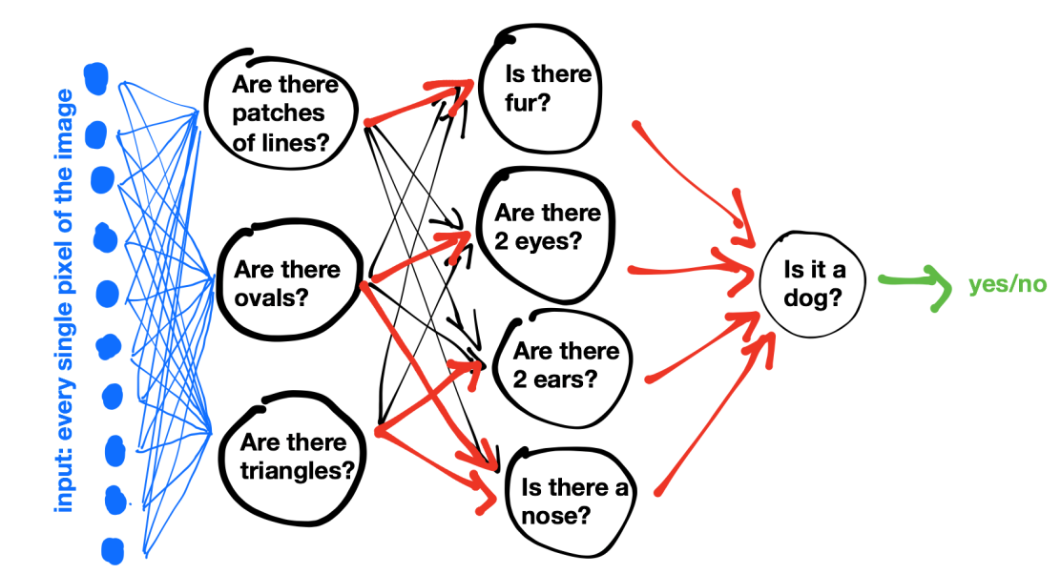
ARTIFICIAL NEURAL NETWORK
Speech Recognition gives 98% accuracy and is good for continuous inputs and troublesome if it converted to discrete

Slide 9
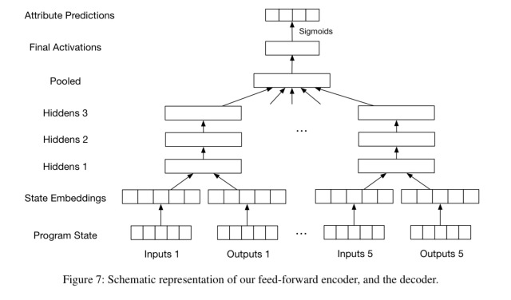
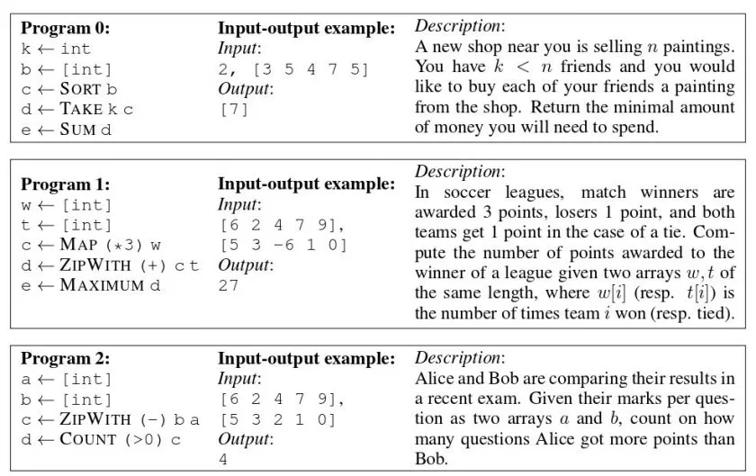
DEEPCODER
DeepCoder gives 98% accuracy and is good for continuous inputs and troublesome if it converted to discrete

Slide 10
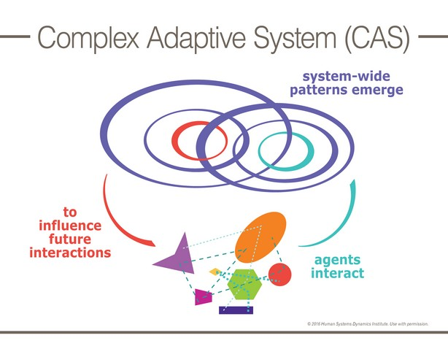
COMPLEX ADAPTIVE SYSTEM

Slide 11
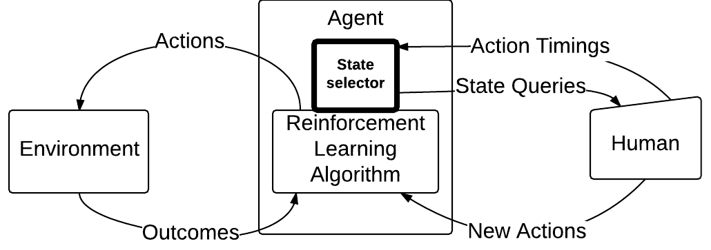
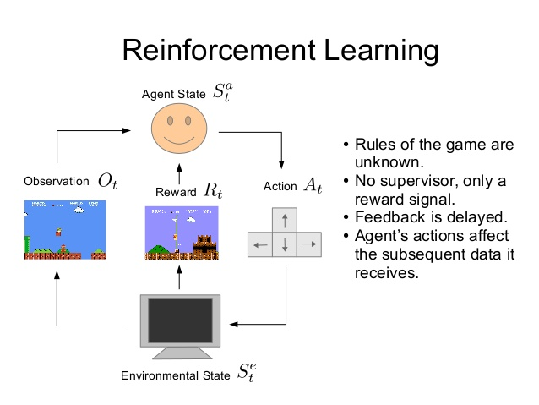
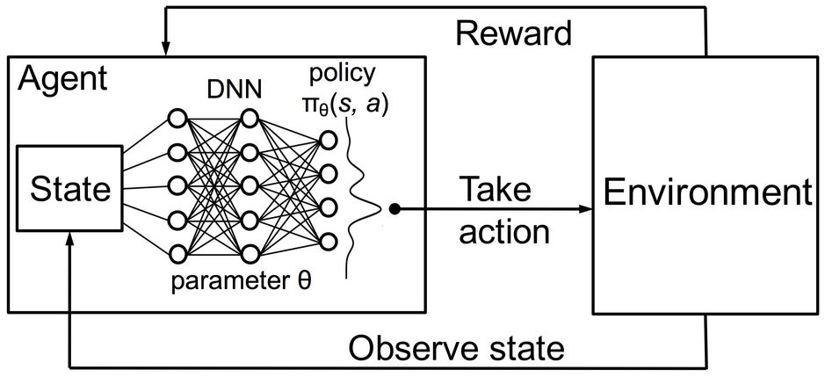
MACHINE LEARNING
Reinforcement Learning is the future of AI, agent can be smarter by implementing reward and punishment without even using thousands of iterations

